Slide 1
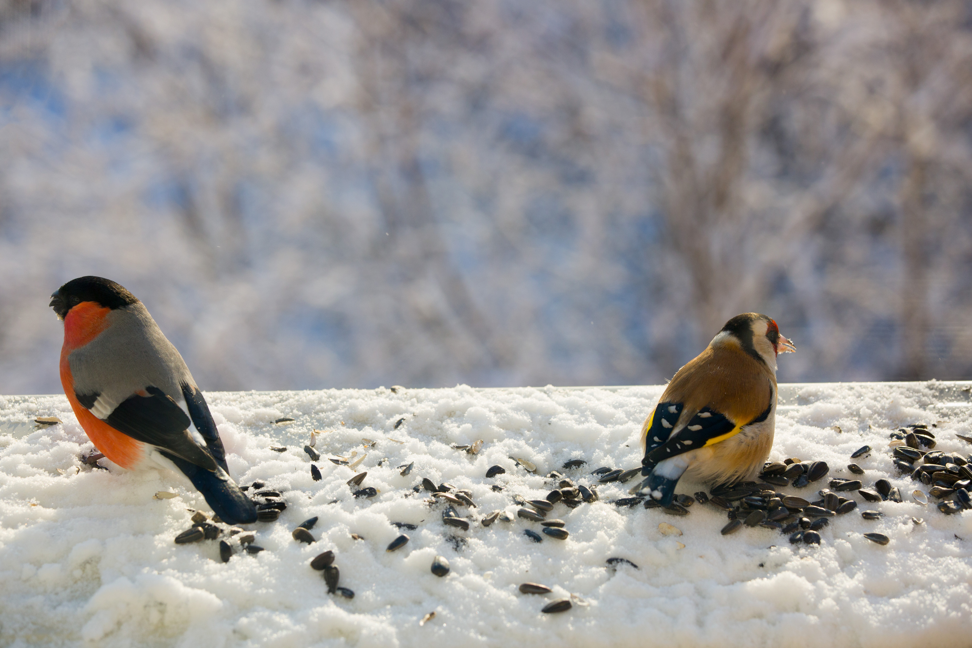



BIRD SOUND RECOGNITION USING A
CONVOLUTIONAL NEURAL NETWORK
Created By:
NIRNOY CHANDRA SARKER
ID- 20101043
SECTION- 02

Slide 2

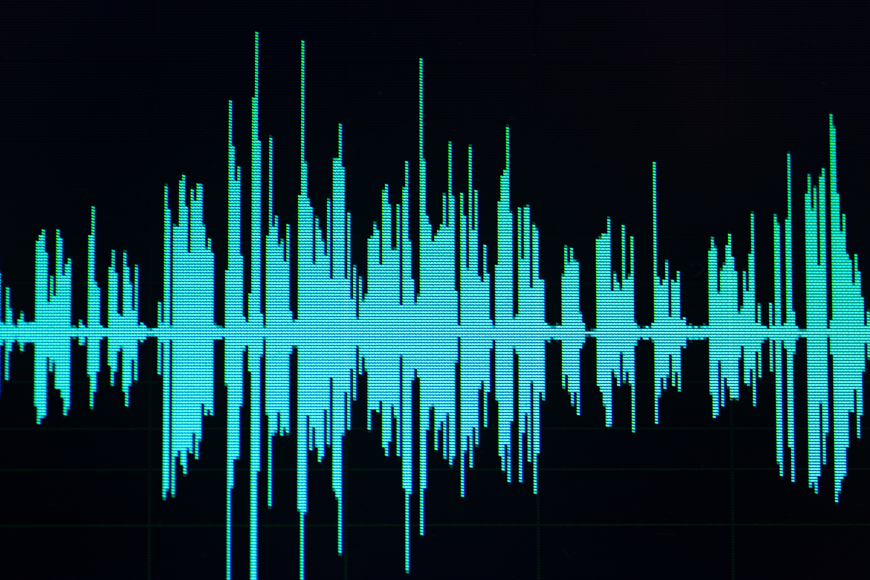

INTRODUCTION
Deep Learning
Neural Networks
Models
Spectrogram

Slide 3




RESEARCH OBJECTIVE
In the field of bird sound recognition using pre-trained Neural Network.
RESEARCH
IMPACT
The study aims to determine whether fine-tuning a pre-trained network with spectrogram images, representing audio data, can lead to accurate bird species classification.
The intended audience consists of naturalists and ornithologists who would want a practical method to distinguish between different bird species based just on auditory characteristics, as it can be challenging to find elusive songbirds in the field.

Slide 4



METHODOLOGY
The data gathering process involves obtaining bird sound recordings from Xeno-canto, an open website for sharing bird sounds. The recordings are converted from MP3 to WAV format and categorized into training and test datasets. Preprocessing steps include splitting the WAV files into equal-length chunks, normalization, and filtering to remove quiet segments. A Short-time Fourier Transform (STFT) is then applied to extract spectro-temporal information, and the resulting data is used to create spectrogram images with different color maps.

Slide 5
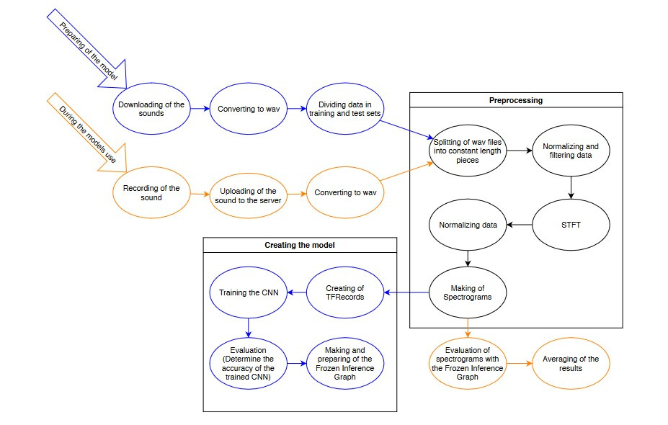

Slide 6

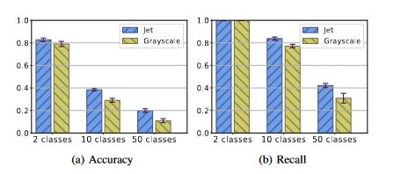
PREDICATE
RESULT
Using fixed hyperparameter values, each configuration is used five times for 10,000 steps to train the networks. The weight decay is set to 0.00004, the learning rate is set to 0.0001, and the dataset split is divided into 32 batches.

Slide 7



CONCLUDING
STATEMENT
To improve accuracy, the study suggests considering larger, more robust pre-trained convolutional neural networks, like ResNet. Additionally, it recommends training the lower layers of the network on grayscale images for a fair comparison between color and grayscale spectrograms.

